Slide 1
A lecture on Canal System in Porifera (1st Semester) By Dr Sabzar A. Dar Assistant Professor Department of Zoology

Slide 2
Introduction
Body of all sponges is perforated by large number of apertures (ostia) through which water enters inside body and flows through a system of criss-crossing canals collectively forming the canal system.

Slide 3
Types of Canal System
Ascon type
Sycon type
Leucon type
Rhagon type

Slide 4
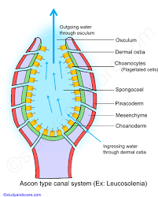
Ascon type
This is the simplest type of canal system and is found in leucosolenia. Ostia are present on the surface of body and lead directly into the spongocoel, which is lined by flagellated choanocyte cells
Spongocoel opens to the outside through a narrow circular opening the osculum located at the distal free end of the sponge body
Water enters through ostia into spongocoel and goes out of the body through the osculum

Slide 5
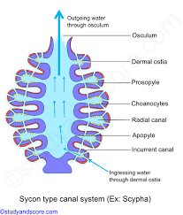
Sycon type
Sycon type of canal system is a characteristic of syconoid sponges, eg., scypha and grantia. Body wall is folded to form incurrent and radial canals, which open into the spongocoel by an opening called apopyle.
Both types of canals are interconnected by minute pores called prosopyle.
Incurrent pores or ostia are found on the outer surface of body and open into the incurrent canals, which lead into adjacent radial canals through minute openings called prospyles.
Radial canals open into central spongocoel by internal openings called apophyles.

Slide 6
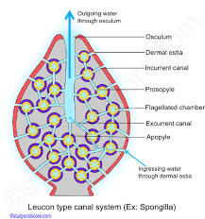
Leucon type
In Leucon type radial canals get divided into flagellated chambers by further folding of body wall. This type of canal system is a characteristic of spongilla.
Incurrent canals open into prosopyles. Flagellated chambers communicate with excurrent canals through apopyles.
Excurrent canals communicate with the outside through a small sponocoel and an osculum.

Slide 7
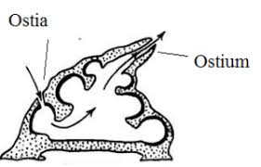
Rhagon type
In desmospongiae, leuconoid condition is derived from the larval stage called rhagon as found in spongilla
The body is conical in shape tapering towards the osculum
The sponocoel is provided with flagellated chambers opening into it by apopyles
Water enters into the cavity through ostium and then enters the incurrent canal prosodous and opens out by aphodus

Slide 8
Significance of canal system
The flagella of choanocytes beat to produce water current, which enters the spongocoel through ostia.
It carries food particles through oxygen and sweeps away the metabolic wastes through osculum.
The canal system serves the function food collection, respiration and excretion.

Slide 9
Thank You

